Slide 1

Democratizing event processing at all scales and platforms with Reactive Extensions
(Rx)
Matthew Podwysocki @mattpodwysocki
@ReactiveX
https://github.com/Reactive-Extensions/NDC-Oslo-2014
Notes:
Alright, we’re here for an Rx talk!
Hi, I’m Matthew Podwysocki from Microsoft
Now the title of this talk is a rather long one called Democratizing event processing at all scales and platforms with the Reactive Extensions or …

Slide 2
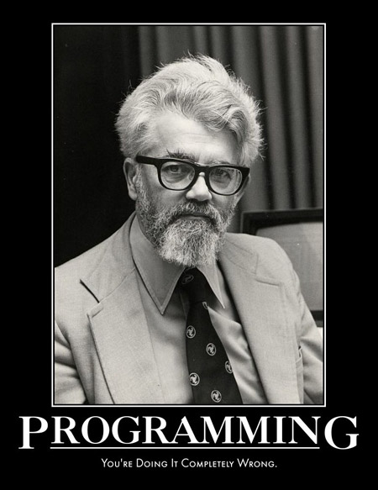

Slide 3

Open Sourcerer

Slide 4


Slide 5
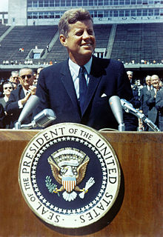
We choose to go to solve asynchronous programming and do the other things, not because they are easy, but because they are hard
Former US President John F. Kennedy - 1962
[citation needed]

Slide 6

OR:
HOW I LEARNED TO STOP WORRYING ABOUT ASYNCHRONOUS PROGRAMMING AND LOVE THE OBSERVABLE
Notes:
How I learned to stop worrying about asynchronous programming and love the observable. I wish I had a cowboy hat about now as I go riding the bomb, but oh well.

Slide 7

Notes:
This is not going to be a typical Erik Meijer style talk where there will be no mention of monads, no category theory harmed during this presentation. And lastly, no, monads are not like burritos.

Slide 8

Notes:
Now, what we’re really talking about here is stream processing and what benefits you can get from it.

Slide 9



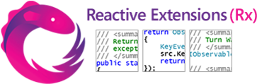

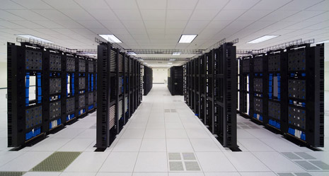

Real-time is everywhere…
RSS feeds
GPS
Stock tickers
Server management
UI events
Social media
Notes:
The world of application development is changing, we are constantly connected to any number of data sources at once. Take for example your phone, it gets texts, GPS, twitter updates, accelerometer movements, and many more things. In fact, it’s hard to find a modern app or device that doesn’t have many connections to it.
This data of course comes in many forms, whether it is stock tickers, RSS feeds, GPS feeds, servers, mouse events and even social media. All of these of course, are databases in one form or another, but in some cases the data just doesn’t exist yet. This mouse here in my hand is a database, as it has infinite amounts of mouse movements clicks and other data, so wouldn’t be it nice to be able to write queries for it? Wouldn’t it be nice to say the same for all these data sources?
How do you do advanced queries over social media in order to see what’s trending
Lots of data over a small period of time that you want to react to
Now, let’s say you want to add another data source? Add in YouTube?
Reaction time is of the essence when dealing with real-time data (don’t want to know what’s trending 5 minutes ago, but *right now*)
Want to be able to compose this with any number of other data sources, either internally or externally (such as user’s interaction with the app, e.g., tagging and commenting)
Coordinating these data sources today is very difficult, and that’s the point of the Reactive Extensions, to unify them all

Slide 10


Slide 11
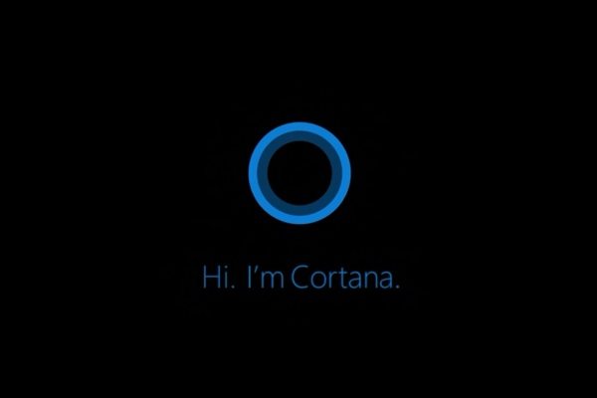



Scalable Abstractions Powering Cortana
Native RxCPP
Small FootPrint
Processing Sensors
Managed code (Rx.NET)
Across Data Centers
Processing the World’s Data
http://channel9.msdn.com/posts/Scalable-Information-Stream-Processing-by-Bing-in-Support-of-Cortana-Scenarios
Notes:
One very real instance of using the Reactive Extensions is through the new technology built into Windows Phone 8.1 with Cortana. How many people have upgraded to 8.1 already? How do you like it?
What’s great about Cortana is that I can say for example remind me to say thank you at the end of my talk. And that’s powered by the Reactive Extensions.
In addition, on the phone, you have Native Reactive Extensions which listen for certain events, such as time-based, geolocation based, etc, that fire when it is appropriate.
This is all then hooked into the cloud, in Bing, for example the leave early reminder, where it hooks into all of the Bing services and says that in order to make it to your destination on time, you need to leave by a certain time. We can hook up your current location with Rx on your phone, to Bing, which knows where your destination is, and knows how long it takes to get there, all through the beauty of Rx.
On the phone, we have a native version of Rx, which has a very small footprint, and very fast. This processes all the sensors really quickly.
On the server-side, we’re using the Reactive Extensions for .NET, and some extensions on top of that, which allow us to scale across data centers, where we process the world’s data. That’s what I mean by all scales. From the very small form factor of your phone, all the way to the data center.

Slide 12



Top-rated Movies Collection
Func<User, IObservable<Video>> getTopRatedFilms = user =>
user.VideoLists
.Select(videoList =>
videoList.Videos
.Where(video => video.Rating === 5.0)).
Merge();
getTopRatedFilms(user)
.Subscribe(film => Console.WriteLine(film));
Notes:
For example, we could query Netflix, using their Observable API to get the top rated movies from the user’s list. We could use the C# expression syntax or extension methods, both work equally well here. We’ll do a select to get the videos, a where filter the ratings and then merge it into a single sequence. Then, we can subscribe to write out each film.

Slide 13
What if I told you…
…that you could create a drag event…
…with the almost the same code?
Notes:
Now, what if I told you, the Netflix API calls we just made, we could do pretty much the same thing with a mouse drag, all with almost the same code? Would you believe me?

Slide 14

Mouse Drags Collection
Func<Element, IObservable<Event<EventArgs>> getElementDrags = elmt =>
elmt.MouseDowns()
.Select(mouseDown =>
mainWindow.MouseMoves()
Where .TakeUntil(elmt.MouseUps()))
.Merge();
getElementDrags(image)
.Subscribe(pos => image.Position = pos);
Notes:
And it turns out we can. If we’re given an element, then imagine we had an extension method that exposed MouseDowns as an observable sequence, then we can use Select to map mouse downs to the mouse moves extension method, stopping when we hit mouse ups. Then we merge it all back together into a nice little sequence. Of course for you C# folks here, we could have used SelectMany and not needed the Merge, but that’s all SelectMany really is, Select and Merge.

Slide 15
Notes:
So, did that grab your attention?

Slide 16

Callback Hell
function play(movieId, callback) {
var movieTicket, playError,
tryFinish = function () {
if (playError) {
callback(null, playError);
} else if (movieTicket && player.initialized) {
callback(null, ticket);
}
};
if (!player.initialized) {
player.init(function (error) {
playError = error;
tryFinish();
}
}
authorizeMovie( function (error, ticket) {
playError = error;
movieTicket = ticket;
tryFinish();
});
});
Notes:
Now callback hell is a very real thing. If you’ve been in the JavaScript world long enough, then you’ve had to deal with trying to do sequential processing of some sort with asynchronous code. Trying to find the logic versus fighting the callback nature, it’s easy to get lost.
You might end up with Indiana Jones and the Callback Temple of Doom where it looks like a sideways pyramid.

Slide 17
Asynchronous Programming is Annoying
Each language has its own way of expressing async/event-based programming
Java futures are different from JavaScript promises are different from Clojure core.async) are different from .NET Tasks
Each concept covers only part of the story
Wouldn’t it be great to have a unifying concept to generalize how we think about concurrent/reactive programming?
Notes:
Each programming language and platform has its own way of expressing ways of getting data via asynchronous programming and events. By themselves, asynchronous and event-based programming is fine as it is per runtime for doing one and only one thing. But they’re ultimately different worlds. Each of these cover its own part, Promises for example for single values, and events for multiple values. You wouldn’t use a promise over events that you might expect more than one.
To make this more concrete, say we need to make a web request to get some data, now let’s combine it with some user input from keystrokes which are events. Now, what if we need to then add a timer so we don’t overload the service? How do we do that?
We just worked with three concepts here, promises, events and timers.
So, wouldn’t it be nice to have a unifying concept over the entire space that we just described?

Slide 18
Reactive Manifesto http://www.reactivemanifesto.org
Merriam-Webster defines reactive as “readily responsive to a stimulus”, i.e. its components are “active” and always ready to receive events. This definition captures the essence of reactive applications, focusing on systems that:
react to events
the event-driven nature enables the following qualities
react to load
focus on scalability by avoiding contention on shared resources
react to failure
build resilient systems with the ability to recover at all levels
react to users
honor response time guarantees regardless of load
Notes:
So, there has been a big buzz around Reactive Programming Lately, and I think partially due to the popularity of the Reactive Extensions. That and the Coursera Course of Reactive Programming came out. How many people did that course? How many actually finished it? Well, you’re all Reactive Programmers now!
The Reactive Manifesto was a document that came out to try and define what exactly reactive programming is. Much like a lot of things like Functional Programming where it’s kind of fuzzy as to what it truly means to be a functional language. Here at least we break it down to its essentials, as in “readily responsive to a stimulus.
It’s broken into four parts,
1: Reacts to Events, so, event driven
2: Reacts to loads, meaning it can somehow deal with load as it comes through
3: React to failure, so, some sort of compensation logic
4: Finally react to users. Give them something timely without locking up the application
That’s it. That’s all you need to know.

Slide 19
OnNext: Reactive Applications Demo
Notes:
Before we demo anything using Rx, let me ask, what’s the most popular Reactive Programming application out there. What do you think it is? That’s right, Excel.
Let’s actually take a look at a number of applications using the Reactive Extensions, and we’ll count the concepts as they go along.
Let’s start out with a simple one, let’s combine together mouse movements and a notion of time, to create an awesome animation.
Next up, let’s look at a more complicated example. What about game programming? How many concepts do you deal with there? Well, usually user input, a notion of time, a game loop of some sort, and things like collision detection. Using the Reactive Extensions, it makes it easier.
Demo:
Time Flies
Alphabet Invasion

Slide 20
Ordinary Interactive Programming
try {
foreach (var item in collection)
DoSomething();
}
catch (Exception e) {
HandleOrThrow(e);
}
DoCleanup();
OnNext(T)
OnError()
OnCompleted()
Notes:
Let’s take a look at some ordinary code that most everyone sees on a day to day basis. Note your programming language might be different, but the concepts are largely still the same. In this case, we’re looking at C#. We iterate over a collection by pulling each item, doing something with it, and handling exception and doing cleanup as necessary.
Logically, each of these concepts map directly from a pull based collection to a push based collection.
OnNext when you want to handle each item.
OnError when you need to handle exceptions
And OnCompleted to do any cleanup

Slide 21

That was the iterator pattern
Notes:
What we just saw was the iterator pattern which is pull based, made famous the world around in the Gang of Four book.
In that book, they also describe a pretty useful pattern turns out that it can be used for push based collections. That is the Subject/Observer pattern. Although it’s not spelled out directly in the book, we found that there is a deep relation between the iterator pattern and a generalized subject observer pattern, that they are duals of one another, push versus pull.

Slide 22
Making it push-based
IObservable<T> collection = ...
var obs = Observer.Create( onNext: x => DoSomething(x), onError: e => HandleError(e), onCompleted: () => DoCleanup());
var subscription = collection.Subscribe(obs);
// deterministically cleans up all resources subscription.Dispose();
Notes:
So, how did we generalize the subject/observer pattern? We’ll break it down into two concepts, the Observer and the Observable.
In the case of Rx, the observable does not need to keep track of all observers. So, they are as decoupled as possible.
Let’s look at some C# code to make this concrete. First, we have an collection of type IObservable<T> which produces values. Next, we create an Observer which will later consume the Observable. We’ll create the observer with three callbacks, one for each new element that is pushed through the collection, an optional error handler, and optional completion handler.
Now how do we connect them? We simply call subscribe passing in the observer that we just created. Now, what we get back is a handle to the subscription.
Donna: Why do we need a handle? Aren’t we done?
There’s no unsubscribe from the Observable, instead, we have a subscription handle which contains all the logic in order to deregister the observer from the observable, so it’s completely decoupled. Not only that, but if we’re dealing with events, then during creating, we add a handle to an event, and in dispose, we remove the event handler.
Taking this a step further, if you combine multiple events together, then disposing the subscription will DETERMINISTICALLY get rid of ALL the resources associated with the subscription, for example all the event handlers at once.

Slide 23
Rx Grammar Police
* ( | ) ?
OnNext
Zero or more values
E.g. events are ∞ sequences
OnError
Calls can fail
OnCompleted
Resource management
Sequencing
ü
0
1
2
ü
0
1
2
ü
Must be a sequence
No concurrent callbacks
One time termination
0
1
û
0
2
1
Notes:
We talked about the three parts of the operation, the onNext, onError and onCompleted.
The onNext will be called zero to infinite times producing values
The onError handler will be at most called once should an operation fail such as a web request
The onCompeted handler will also be called at most once at the end of an operation if there is one.
Why do we need a grammar to formalize this?
Reason for grammar:
in interactive programming, know exactly when you’re going to get the next element
since elements are spaced out over time, we make the grammar explicit
this is the exact same grammar as a pull-based collection (if there’s an error, can’t get more elements, can’t get to the end twice

Slide 24
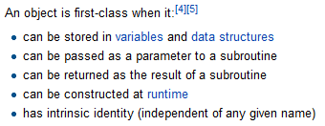

First-Class Events Objects to the rescue
How about a query library?
Or mocking for testing…?
Notes:
The great news is with Observables, we now have a concept of a first class event. What does that mean? Well, you can take one as an argument, you can return it from a function. What does that buy you exactly?

Slide 25

Notes:
Now there’s a lot out there about async/await in C#, generators in other languages such as Python. This is great stuff that we actively use because it helps us with our one and done kinds of things such as Web Service calls, and any other async code, without having nasty callbacks all over the place.

Slide 26
Observables are awaitable…
static async Task<int> DoStuff()
{
var observable = Observable.Return(42);
return await observable;
}
static async void GetStuff()
{
var value = await DoStuff();
Console.WriteLine(value);
}
Notes:
And sure enough, with the Reactive Extensions, you can easily use async/await within your application which gets the last value from the observable sequence. Pretty handy! So once again, it’s easy to keep using the Reactive Extensions and mixing that with Task based upon what you’re trying to do.

Slide 27
Notes:
Of course some might say use Task<T> only for a lot of things, and I couldn’t disagree more. For example, how about simple retries? With Rx, you get all of that with extension methods such as Retry, Catch, OnErrorResumeNext

Slide 28
Observables are more powerful…
async Task<int> GetMovies()
{
var observable = service.GetMovies().Retry(3)
return await observable;
}
async void ProcessMovies()
{
var movies = await GetMovies();
Console.WriteLine(movies.Count);
}
Notes:
And sure enough, with the Reactive Extensions, you can easily use async/await within your application which gets the last value from the observable sequence. Pretty handy! So once again, it’s easy to keep using the Reactive Extensions and mixing that with Task based upon what you’re trying to do.

Slide 29
What is Rx?
Language neutral model with 3 concepts:
Observer/Observable
Query operations (map/filter/reduce)
How/Where/When
Schedulers: a set of types to parameterize concurrency
Notes:
What is Rx anyways?
We can boil it down to three main concepts
1 The observable and observer objects
2 Query operations such as map, filter, reduce, etc
3 We need to control how/when and where an operation is fired, therefore we have a notion of schedulers.
But the key point here is that these concepts are completely language neutral, in fact we have a number of implementations…

Slide 30
Rx is everywhere*
.NET
JavaScript (RxJS)
Java (RxJava)
+ Scala, Groovy, Clojure
Objective-C (ReactiveCocoa)
C++
Python
Ruby
PHP
Dart
Haskell
Swift???
* Varying levels of completeness – YMMV
Notes:
There are lots of implementations of Rx in varying levels of maturity
Of course there’s the .NET, JS, C++, Python and even Ruby from Microsoft
RxJava was open sourced by Netflix with adapters for Scala, Groovy and Clojure
ReactiveCocoa was open sourced by GitHub and is a core part of their GitHub client for the Mac
The community has also contributed with Dart, Haskell, PHP and others

Slide 31
What is Rx?
Language neutral model with 3 concepts:
Observer/Observable
Query operations (map/filter/reduce)
How/Where/When
Schedulers: a set of types to parameterize concurrency
Notes:
The second component of Rx is query operators.
Remember how we said that push-based collections are the dual of pull-based collections? Well, because of that, we can do essentially the same operations on push collections. Functional programming has given us a rich set of higher order functions that can be applied to lists. The cool thing is that most of these make sense on *any* sequence of data, regardless of whether it is push or pull-based.
This is the key that makes Rx not just another concurrency library—it gives you higher-order operations.

Slide 32
Reactive collections: the dual of iterable collections
IEnumerable
pull
foreach
T Current, bool MoveNext()
throws Exception
returns
IObservable
push
Subscribe(IObserver)
OnNext(T)
OnError(Exception)
OnCompleted()
// IEnumerable<Stock>
// Historical stock data
stocks
.Where(q => q.Symbol == "FB")
.Select(q => q.Quote)
.ForEach(Console.WriteLine);
// IObservable<Stock>
// Incoming stock feed
stocks
.Where(q => q.Symbol == "FB")
.Select(q => q.Quote)
.Subscribe(Console.WriteLine);
Notes:
So to really show this duality, on the left here we have IEnumerable. (Note that I’m using C# here, but every programming language has a similar type.)
So, what can you do with a pull-based collection? Well, you can loop over it, get the current element, and move to the next element. If there’s an error, you’ll get an exception. And there’s no explicit OnCompled, since you’re done when you’re done iterating.
Since Observable is the dual of Iterable, you can do the exact same operations, but they are just inverted (pull becomes push)
Foreach becomes Subscribe, getting the current element and moving forward one, OnError is the dual of getting an exception, and OnCompleted doesn’t really have a direct counterpart—it’s just when you’re done with your loop.
So, let’s look at an IEnumerable query and see how it compares to an observable one. Rather than checking your facebook feed, let’s check a stock feed for Facebook. So, we filter, map, and loop.
In IObservable, we do almost the exact same thing.
(click) Filter and Map are the same, and ForEach becomes subscribe

Slide 33
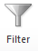
Marble diagram: filter
dots
.filter(function (dot) {
return dot.isOrange();
})
results
Notes:
Let’s look at a graphical representation of how some of the operators behave. This is what we call a marble diagram, which just shows the order in which elements are received.
Here, let’s filter the sequence and return only the orange marbles. (this is JavaScript code) Notice that we filter each element as it is received, rather than what we could do in a pull collection which would be to process all the elements and return a new filtered list.
So, the results observable will receive an OnNext at essentially the same time that the orange items came in the source sequence.

Slide 34
Marble diagram: map
input
map( => )
.map(function (item) {
return transform(item);
})
results
Notes:
So another classic functional operator is map. And, it behaves pretty much like you expect.
Let’s apply a map function that turns the circles into triangles. Again, just like with filter, we get each new observable element in the same order and about the same as the source sequence (modulo the time it takes to actually run the map operation)

Slide 35

Marble diagram: delay
Since Observables are asynchronous, they have a notion of time
input
.delay(1000)
results
Notes:
Since all of these queries have some notion of time (either implicit or explicit), there are also operators that directly involve time, such as delay. So here’s a graphical representation of what that might look like.

Slide 36
The Asynchronous Programming Landscape
IEnumerable<T>
IObservable<T>
res =
stocks
.Filter(q => q.Symbol == "FB")
.Map(q => q.Quote)
foreach (var x in res)
...
res =
stocks
.Filter(q => q.Symbol == "FB")
.Map(q => q.Quote)
res.Subscribe(x =>
...
Multiple values (*)
T
Task<T>
Single value (1)
var y = await fAsync(x);
var z = await gAsync(y);
var y = f(x);
var z = g(y);
Synchronous
Asynchronous
Notes:
So I talked about the duality of push and pull collections. There are 2 axes that we can look at some of these concepts, single values vs. multiple values, and synchronous vs. asynchronous.
Synchronous single value is just a value of type T.
A synchronous collection is an IEnumerable<T> (or Iterable or whatever your language calls it)
An asynchronous, single value item is a Task or a Promise or a Future (here’s the C# version)
And, as we just saw, if something is asynchronous and multi-valued, it’s an IObservable.

Slide 37
OnNext: Drag and Drop
Notes:
Now let’s take the code in action.

Slide 38
Querying UI Events
var mousedrag = mousedown.flatMap(function (md) {
// calculate offsets when mouse down
var startX = md.offsetX,
startY = md.offsetY;
});
1
For each mouse down
Notes:
This example is in JavaScript, and we can get our event handlers using a bridge library to Angular, jQuery, Dojo, MooTools, even plain old HTML, we have a plugin for that.
We can start off by taking the mouse down events and calling flatMap or for those C# minded, selectMany, which is essentially mapping each value to a set of values and then flattening it, so you don’t end up with a sequence of sequences. Then we can start by getting the starting position for later usage.

Slide 39
Querying UI Events
var mousedrag = mousedown.flatMap(function (md) {
// calculate offsets when mouse down
var startX = md.offsetX,
startY = md.offsetY;
// calculate diffs until mouse up
return mousemove.map(function (mm) {
return {
left: mm.clientX - startX,
top: mm.clientY - startY
};
})
});
1
For each mouse down
2
Take mouse moves
Notes:
Now what we’re going to do is then take the mouse movements and map them so that we calculate the offsets between the starting location when the mouse button went down and when the mouse began to move, so that we could reposition our image to the new location.
Now, how do we stop listening? You stop when the mouse goes up

Slide 40
Querying UI Events
var mousedrag = mousedown.flatMap(function (md) {
// calculate offsets when mouse down
var startX = md.offsetX,
startY = md.offsetY;
// calculate diffs until mouse up
return mousemove.map(function (mm) {
return {
left: mm.clientX - startX,
top: mm.clientY - startY
};
}).takeUntil(mouseup);
});
1
For each mouse down
2
Take mouse moves
3
until mouse up
Notes:
We can get that exact behavior that we’re looking for by using the takeUntil operator which stops the sequence when another observable sequence fires.
Now we can easily say that mouse drag is really just mouse down and mouse move until mouse up, which is exactly what we’re showing here.

Slide 41


Composing Events and Promises
Observable of strings
XHR web service request
keyup
Dictionary web service
React
Reaction
Reactive
Reactor
Data binding on HTML page
Observable of arrays of words
Notes:
The Reactive Extensions could also be used in a typeahead or autosuggest scenario. What’s seemingly a pretty easy concept can get bogged down in the details.
As we start typing, we listen to they keyup event which would produce an Observable of strings
Next, we’re going to take the data and send it to a Dictionary service via a Promise, which we can convert to an observable sequence which will have at most one element. But we have to be mindful in cloud scenarios where bandwidth is money and we don’t want to introduce too much latency by overwhelming the service as we type.
Then we’ll get back an Observable array of data which we can then bind to the page easily .
Now how does that work?

Slide 42
Composing Events and Promises
DOM events as a sequence of strings
var words = Rx.Observable.fromEvent(
input, "keyup")
.map(function() { return input.value; })
.throttle(500)
.distinctUntilChanged()
.flatMapLatest( function(term) { return search(term); } );
words.subscribe(function(data) {
// Bind data to the UI
});
Reducing data traffic / volume
Latest response as word arrays
Web service call returns single value sequence
Binding results to the UI
Notes:
By using the DOM bindings, we can extract the keyup events from the input by using the Rx.DOM.fromEvent function. Then we can extract the value from the textbox through the map function.
As we said before, we don’t want to overload the service with requests for every key we type, instead we only want to make sure we wait for a pause of half a second, and ensure we are firing when text has truly changed. Keys such as arrows don’t change the text itself, therefore the observable sequence won’t fire.
Next we need to take the throttled input and query the dictionary service. Proper handling of asynchronous behavior is important and order matters. If I type react then type reactive, yet reactive comes back first, we don’t want to have the result from our first request to clobber the results from our last. That’s a typical mistake I see in a lot of applications. To fix that, we call flatMapLatest in which your map function returns an observable of observables and then flatMapLatest cancels all previous requests and only returns the latest value.

Slide 43
What is Rx?
Language neutral model with 3 concepts:
Observer/Observable
Query operations (map/filter/reduce)
How/Where/When
Schedulers: a set of types to parameterize concurrency
Notes:
The third piece of the reactive extensions is this notion of schedulers which control how, when and where an operation happens. This here is really the heart or rather the brain of the reactive extensions, and what makes it unique from any other functional reactive programming library.
At any point in the query, we should be able to change the concurrency model or simply where the code executes. As we saw previously, Donna used ObserveOnDispatcher to ensure that the observer notified on the dispatcher thread. But note that the timer and all other observables could happen on another thread, so you don’t have to lock the UI for the entire query.

Slide 44
The Role of Schedulers
Many implementations
Cancellation
Key questions:
How to run timers?
Where to produce events?
Need to synchronize with the UI?
Schedulers are the answer:
Schedulers introduce concurrency
Operators are parameterized by schedulers
Provides test benefits as well
d = scheduler.schedule(
function () {
// Asynchronously
// running work
},
1000);
Optional time
Notes:
We have some key questions to ask whenever you are doing an asynchronous computation.
How do run a timer?
Which thread or which machine will receive an event?
Do we need to be on a special thread for updating the system?
Schedulers are a single answer to all of the questions
They introduce concurrency
Many operators provide overloads with schedulers which allow you to change the concurrency model
This also provides us with a huge testing benefit which we’ll see in the next slide.

Slide 45
Testing concurrent code: made easy!
var scheduler = new TestScheduler();
var input = scheduler.createColdObservable( onNext(300, "NDC"), onNext(400, "OSLO"), onCompleted(500));
var results = scheduler.startWithCreate(function () { input.map(function (x) { return x.length; }) });
results.messages.assertEqual( onNext(300, 3), onNext(400, 4), onCompleted(500));
Notes:
Writing asynchronous code in any language is hard enough, but testing it can be a nightmare. You could be caught in thread sleeps or timers to test whether asynchronous behavior happened.
The Reactive Extensions solves this through a virtual time scheduler. There are a number of them built in including an HistoricalScheduler for replaying historical data, but also there’s a (click) TestScheduler whose sole purpose is to provide a mechanism for deterministic testing without having to create any artificial delays.
(click)
We can also simulate observables which fire at predefined virtual times with values. This happens all in real time, no waiting required. I could in fact schedule something for the next CodeMash next year and deterministically check that my code does the right thing. Here, we’re creating an observable with two elements, strange and loop to fire at 300 milliseconds and loop to fire at 400, and a completion message at 500 ticks or virtual time.
(click)
We can get the results from our query of getting the length of each string by using the scheduler which tracks all the values and when they were produced with a virtual timestamp.
(click)
Finally, we can verify the results that at 300 milliseconds, we get a string with length of 7 and at 400 milliseconds a string of length 4 and a completion message at 500 milliseconds.
You could turn an Enumerable into an Observable such as test data from a file, and you don’t have to make your code convoluted just to make it testable.
This style we show here is exactly how we wrote our unit tests for all of our operators.

Slide 46




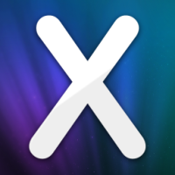


More about Rx
Open-sourced by MS Open Tech in Nov 2012
Rx.NET, RxJS and RxCPP
Who uses Rx?
Netflix ported it to Java (RxJava)
Heavily used in back-end
Use RxJS/Rx.NET on clients
GitHub
GitHub for Windows (ReactiveUI + Rx.NET)
GitHub for Mac (ReactiveCocoa)
OctoKit
Splunk
Splunk SDK
Notes:
MS Open Tech open sourced Rx last year, and put out implementations for .NET, JavaScript and C++. If you haven’t heard of them, MS Open Tech is a wholly-owned subsidiary of Microsoft and does a lot of open-source work including Node.js, Redis, OpenJDK and so forth.
A couple of examples of people using Rx in production: Netflix and GitHub.
Rx was shipped on the Windows Phone ROM, Xamarin Studio has a package, Soundcloud uses it, among others.

Slide 47
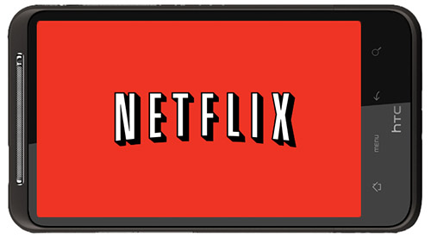
Reactive Programming at Netflix
Notes:
Now, let’s talk about Reactive Programming at Scale. For example, we have a large partner that I’ve been working with at Microsoft called Netflix. Heard of them? They happen to have a booth here as well.

Slide 48
Netflix
Stream movies to your TV, game console, or mobile device
Responsible for 1/3 of US Broadband Traffic
Notes:
They happen to be one of the largest sites in terms of traffic here in the US. And guess what they use to power a lot of their APIs, front ends and back ends? You guessed it, Rx.

Slide 49
Two Years Ago…
Complex async code
Client and Server developers tightly coupled
Different platforms, different approaches to async
Notes:
Two years ago, Jafar Husain, who I worked with previously on Rx at Microsoft, as he was on the Silverlight team, they found their code to be quite complex. A lot of async behavior everywhere. Not only that, but the client and server development was tightly coupled, so the front end had to have intimate knowledge of the back end.
What was worse, is that each platform, whether it was the client or the server, had its own approaches to asynchronous programming, so if a developer went from project to project, they’d have to pick up a new style. That takes a lot of time and effort.

Slide 50
Today
Rx used on server and client
30+ developers using Rx in 5 different languages
Same async model everywhere
Notes:
Fast forward to today, where Rx is used both on the client and the server. They heavily use RxJava on the back end with Java for their APIs and other things. And on the client, it’s Groovy using Rx to call the back end, and RxJS on the client. You also have Clojure, C#, Scala and other languages used.
The most important thing is that they may be using different programming languages, but they’re speaking the SAME language throughout, which is Rx.

Slide 51
End to End Reactive Programming at Netflix
Notes:
So, let’s talk end to end reactive programming at Netflix

Slide 52
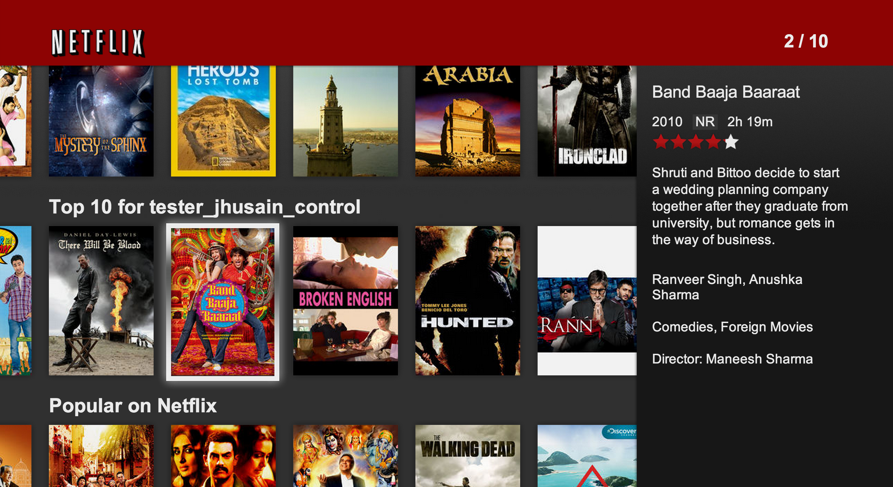
Your Netflix Video Lists Netflix Row Update Polling
Notes:
Here’s another hard problem that we face pretty much on a daily basis. How do we only load what’s in view, so when you scroll, you’re only loading what you need. Then, when it’s out of site, then, well, we can clean up the DOM and keep our memory footprint low.

Slide 53
Client: Polling for Row Updates
function getRowUpdates(row) {
var scrolls = Rx.Observable.fromEvent(document, "scroll");
var rowVisibilities =
scrolls.throttle(50)
.map(function (scrollEvent) { return row.isVisible(scrollEvent.offset); })
.distinctUntilChanged()
.publish().refCount();
var rowShows = rowVisibilities.filter(function (v) { return v; });
var rowHides = rowVisibilities.filter(function (v) { return !v) });
return rowShows
.flatMap(Rx.Observable.interval(10))
.flatMap(function () { return row.getRowData().takeUntil(rowHides); })
.toArray();
};
Notes:
So, how do we poll for updates on the client based upon scrolling?
We start off by getting the scrolls, then we get the row visibilities, throttling it just a little bit so that we’re not firing it too many times, then we’re going to determine whether the row is visible, make sure it’s distinct (meaning true/false), and then share it out to the world.
We can then create rowShows and rowHides streams based upon whether it is visible or not.
Now, it’s just simple composition, take the row shows, chain it to an interval of 10 ms, then chain it to getting the row data, until the row is hidden. Finally, returning it all as an Observable of an array.

Slide 54
Server: Retrieving Social Row
IObservable<List<dynamic>> GetSocialRowData() {
return Observable.RelationalJoin(
socialService.GetFriends(user),
messageService.GetNotifications()
.Where(notification => notification.Video.IsAvailable),
friend => friend.Id, // join key selector
notification => notification.Friend.Id, // join key
(friend, notification) =>
new {
Id = notification.Id,
Name = notification.Video.Name,
Message = notification.Message,
Friend = new { Name = friend.Name, Id = friend.Id }
}).
ToList();
}
Notes:
Now on the server, how about another kind of piece such as getting movies that I recommend to my friends? Say that I’m friends with you and I want to let you know you should watch this movie. How would that work on the server?
We can retrieve some social information, by using an operator we’re creating for Rx vNext for relational joins. Right now we have for time based joins, but Netflix went ahead and implemented a relational join and we’ll be incorporating it shortly. Anyhow, what we can get do get our friends, and get our notifications where video is available, joining on our friend’s ID.
Then we can project forward some information such as the name of the movie, the message, friend, etc, send it off as a Observable of a List.

Slide 55
Netflix uses Rx for…
Data Binding
Data Access
Animations
Building Complex Events
Notes:
As you can see, Netflix uses Rx for all sorts of things such as data binding, data access via their API, animations using RxJS, and building complex events at every level.

Slide 56
The Future Of Rx…
What are the problems we’re looking at next?
Backpressure
Distributed Rx
Query Expressions in JavaScript
Rx-Lite
Custom RxJS Builds
Notes:
What’s in store for 2.3? Good question!
First thing, we’re looking at the notion of backpressure, where we’ll be able to do pause/resume semantics on streams
Next, distributed Rx, looking at different models for query distribution.
We’re also finishing up our query expression support in JS for both RxJS and IxJS, which will allow you to write such things as LINQ to IndexedDB, Odata, etc
And finally, a slimmed down version of the Reactive Extensions overall, taking our lessons learned to get a smaller subset to make it a bit easier to approach instead of our 60 some odd operators.

Slide 57
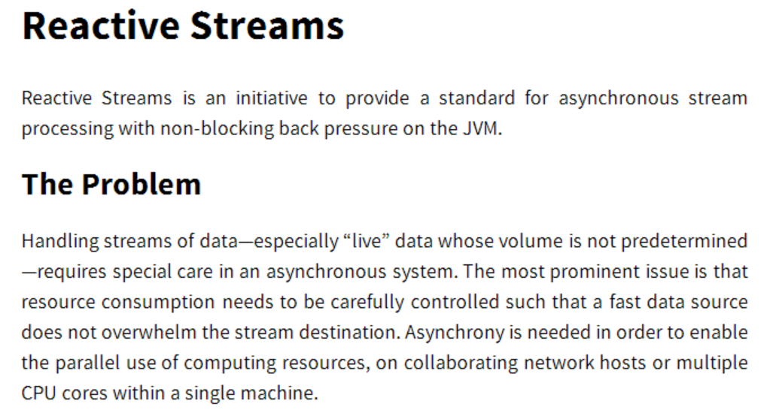
http://www.reactive-streams.org/

Slide 59
A Glimpse into the Future - RxJS and Generators
var Rx = require('rx');
var request = require('request');
var get = Rx.Observable.fromNodeCallback(request);
Rx.spawn(function* () {
var a = yield get('http://localhost/stocks1.csv').retry(3);
console.log(a.length);
try {
var b = yield get('http://invalidhost');
} catch (e) {
console.log(e.code);
}
});

Slide 60
OnCompleted: Rx
Language neutral model with 3 concepts:
Observer/Observable
Query operations (map/filter/reduce)
Schedulers: a set of types to parameterize concurrency
@ReactiveX
github.com/Reactive-Extensions
rx.codeplex.com
https://github.com/Reactive-Extensions/NDC-Oslo-2014
Notes:
So, there you have it. Rx is the notion of an observable, a set of query operations, and schedulers to parameterize concurrency.
You can contact us on Twitter and we have a git repositories hosted on CodePlex and GitHub.
We take pull requests! We’re actively looking for contributions and samples and documentation.
Try out Rx in your favorite language and see what you think! Blog or tweet about your experience tell us what can be made better.

Slide 61


